Slide 1

How-to Video Here:
https://esri.box.com/v/DevSummit2019-HowTo

Slide 2
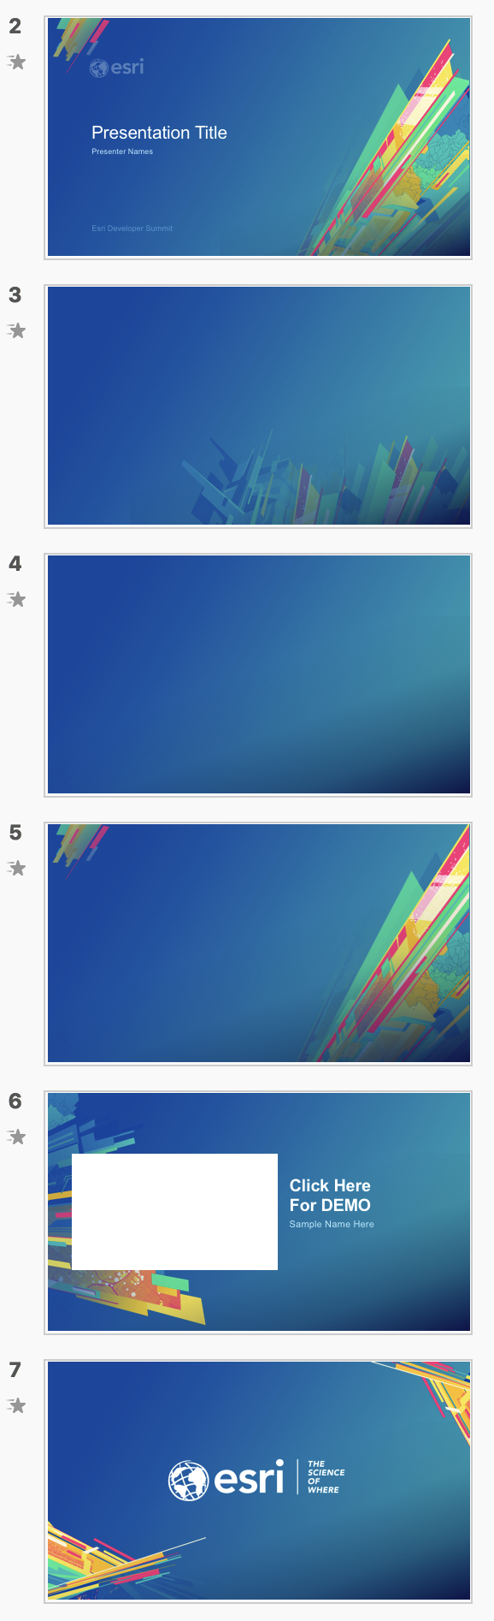
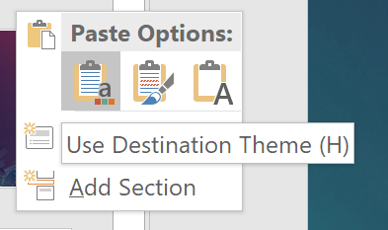
How to apply this template to existing slides
Which background to use?
Title
Open your previous presentation.
Copy all relevant slides from previous presentation to this template. Paste using Destination Theme.
Going slide by slide, copy the Standard Background image of your choice.
Paste and send to back. Windows shortcut: Ctrl+Shift+[
Delete any remaining pieces left from the old background.
For other backgrounds (Title, Section Divider, Demo Intro, and Walkaway) use the provided slides in this template.
Check your fonts. The default font is Arial to maintain consistency across the enterprise. If you used Avenir previously, consider switching to Arial to avoid unknown font substitution by other users. Instructions for changing font themes.
Why not use PowerPoint’s template features?
Standard Background Suitable for Less Content
Standard Background Suitable for More Content
Section Divider
Demo Intro
—
Use behind Images
Walkaway
Notes:
G243257 DevSummit 2019 Template for Esri staff

Slide 3


Presentation Title
Presenter Names
2019 ESRI DEVELOPER SUMMIT
Palm Springs, CA
Notes:
G243257 DevSummit 2019 Template for Esri staff

Slide 4


Slide 7

Click Here For DEMO
Sample Name Here

Slide 8


Slide 9

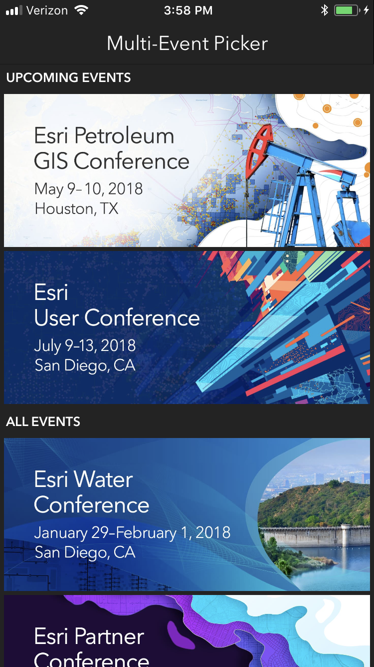
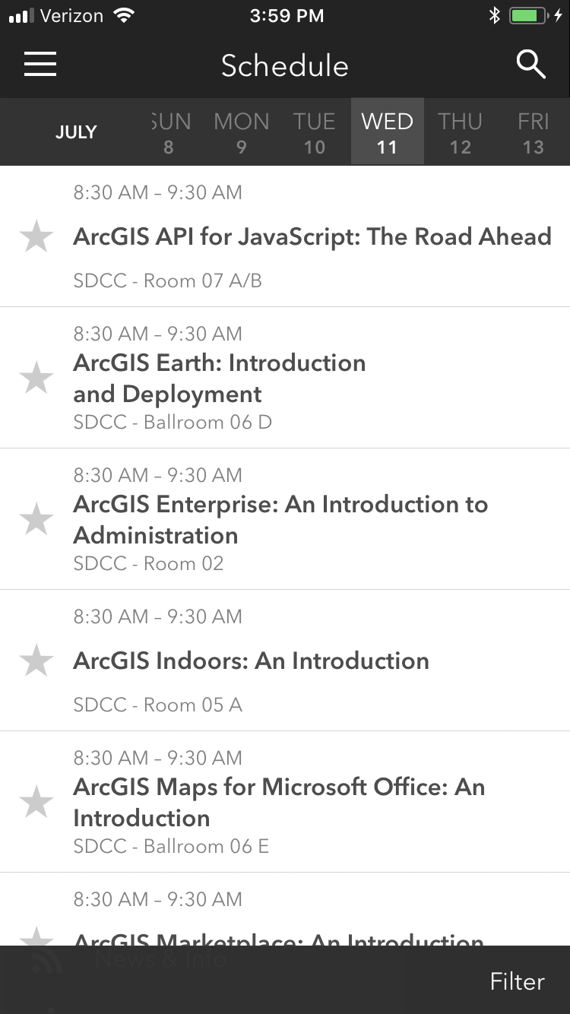
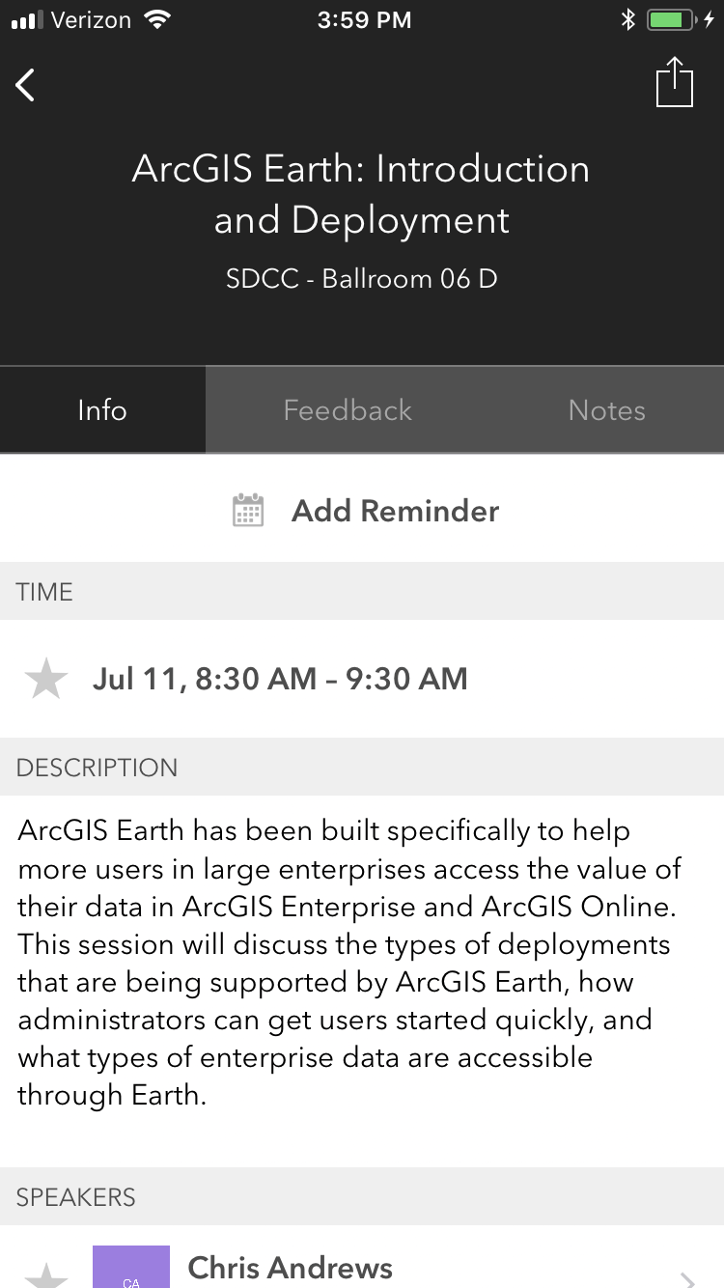
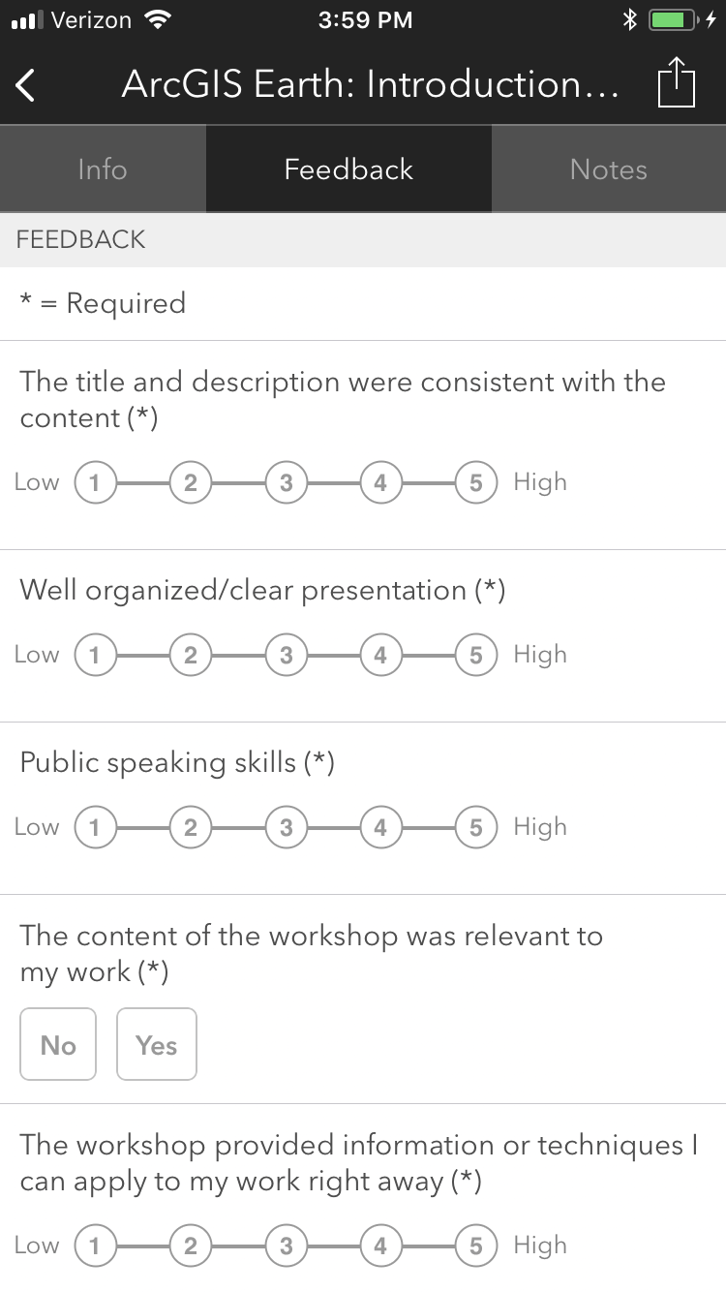
Please Take Our Survey on the App
Download the Esri Events app and find your event
Select the session you attended
Scroll down to find the feedback section
Complete answers
and select “Submit”

